Slide 1


Air Force Institute of Technology
NENG 791 – Proliferation of Weapons of Mass Destruction
Delivery System Proliferation
Lt Col Fee
E d u c a t i n g t h e W o r l d ’s B e s t M i l i t a r y
Notes:
Welcome to the penultimate block of instruction on nuclear proliferation.
http://tutorials.nti.org/delivery-system/introduction/

Slide 2
Why Worry About Delivery Systems?
Proliferation of the actual WMD is only part of the equation—delivery system is the other part
International community increasingly aware that combating proliferation of WMD must evolve in parallel with combating the proliferation of means of their delivery
Missiles may be the delivery method of choice for a nuclear weapon for a State actor but is this always true? What about for a non-State actor?
Ballistic missiles may not be the most efficient way to deliver chem/bio
UAVs and cruise missiles may offer a better alternative for chem/bio
http://tutorials.nti.org/delivery-system/introduction/
Notes:
Taken from: http://www.europeanleadershipnetwork.org/controlling-proliferation-of-wmd-delivery-means-necessary-next-steps-_665.html
Today more than 30 countries have ballistic missiles and over 20 countries have cruise missiles.
Many more have combat aircraft and others are pursuing these technologies.
Their proliferation increases the risk additional countries will be able to carry out WMD attacks and fuels regional and global instability.
Countries have turned to a variety of diplomatic and military tools to address the proliferation of delivery systems, including arms control agreements, missile defense capabilities, and cooperative mechanisms to regulate trade in delivery systems and interdict their illicit shipments.
https://www.youtube.com/watch?v=mkEZFBQp_jg&feature=player_embedded
What is a ballistic missile? A delivery vehicle powered by a liquid or solid fueled rocket that primarily travels in a ballistic (free-fall) trajectory. The flight of a ballistic missile includes three phases: 1) boost phase, where the rocket generates thrust to launch the missile into flight; 2) midcourse phase, where the missile coasts in an arc under the influence of gravity; and 3) terminal phase, in which the missile descends towards its target. Ballistic missiles can be characterized by three key parameters – range, payload, and Circular Error Probable (CEP), or targeting precision. Ballistic missiles are primarily intended for use against ground targets.
What is a cruise missile? An unmanned self-propelled guided vehicle that sustains flight through aerodynamic lift for most of its flight path. There are subsonic and supersonic cruise missiles currently deployed in conventional and nuclear arsenals, while conventional hypersonic cruise missiles are currently in development. These can be launched from the air, submarines, or the ground. Although they carry smaller payloads, travel at slower speeds, and cover lesser ranges than ballistic missiles, cruise missiles can be programmed to travel along customized flight paths and to evade missile defense systems. - See more at: http://tutorials.nti.org/glossary/?term=Cruise missile#sthash.NHT5EFPI.dpuf

Slide 3
Delivery Vehicles
Can be very simple or complex
Dependent on intended use
Range
Desired accuracy
Payload amount and type
Ability to evade or penetrate defenses
Vulnerability to preemptive attack
Cost & infrastructure requirements
Examples:
Truck
Cargo container
Submarine
Combat aircraft
Ballistic missile
Cruise missile
Etc.
Notes:
Can you provide examples of simple or complex delivery systems?
How does the intended use impact selection of the delivery system?

Slide 4
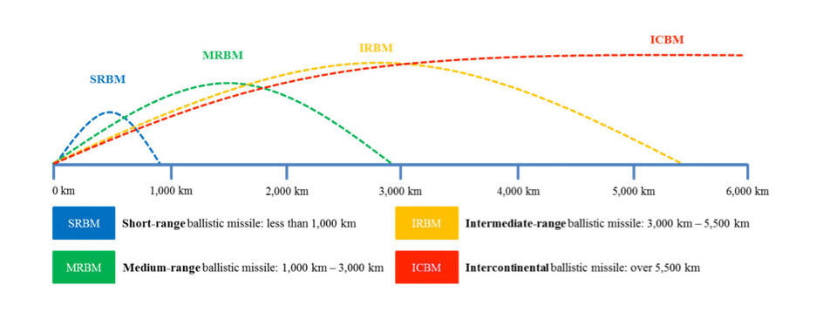
Delivery Systems
Ballistic missiles, cruise missiles, combat aircraft, UAVs, and crude Non-State Actor Delivery Methods
Notes:
Ballistic missiles
A rocket powered delivery vehicle that is initially guided for a brief period but then follows a trajectory governed by gravity and air resistance
Can be launched from fixed silos, mobile launchers, or at sea from surface ships of submarines.
Can carry a single or multiple warheads
Divided into four categories depending on their range.
Cruise missiles—essentially unmanned, fixed wing aircraft using a jet engine and wings to fly a warhead to a target.
They are generally smaller and slower than ballistic missiles but can be extremely accurate and fly at very low altitude, enabling them to avoid detection.
Usually categorized based on their intended targets and launch platforms.
Combat Aircraft
UAVs
Crude non-state actor delivery methods—you name it…
Delivery system attributes: http://tutorials.nti.org/delivery-system/introduction/

Slide 5
Proliferation Challenges
How many countries have ballistic and/or cruise missiles?
Currently, over 30 countries possess one or more types of ballistic missiles.
Iran, Iraq, Libya, Russia, Syria and Yemen have all used ballistic missiles during military operations in recent international conflicts.
More than 20 countries possess land-attack cruise missiles, though they have spread more slowly than ballistic missiles.
At least ten countries will be involved in the production of land-attack cruise missiles over the next decade, with several making their missiles available for export.

Slide 6
Proliferation Challenges
How do countries acquire missile technology?
The U.S. and Soviet missile programs were based on technologies and expertise from Germany following the Second World War.
Most countries begin missile programs with simple liquid-fueled rockets similar to North Korea’s Scud-based missile programs.
Many states start by purchasing Scud-based ballistic missiles.
Other countries, including Iraq, South Korea and Taiwan, acquired surface-to-air missiles and modified them to serve as surface-to-surface ballistic missiles.
Notes:
The U.S. and Soviet missile programs were based on technologies and expertise from Germany following the Second World War.
Most countries begin missile programs with simple liquid-fueled rockets similar to North Korea’s Scud-based missile programs. These states master technologies and techniques, such as staging and clustering engines, along the way toward more sophisticated, longer-range missiles.
Many states start by purchasing Scud-based ballistic missiles, supplied either directly by the Soviet Union or indirectly by third parties, such as North Korea, which reverse-engineered the Soviet Union’s missiles.
Other countries, including Iraq, South Korea and Taiwan, acquired surface-to-air missiles and modified them to serve as surface-to-surface ballistic missiles.

Slide 7
Proliferation Challenges
How do countries develop indigenous missile design and production capabilities?
Origins in past programs
Purchase (or recover) and reverse engineer them
Imported foreign production lines
Espionage
Space launch programs
Notes:
Every national program to develop ballistic or cruise missiles derives, in some part, from past programs.
States that purchase ballistic missiles or surface-to-air missiles may attempt to reverse-engineer them. In some cases, states have acquired technologies from the wreckage of ballistic or cruise missiles used in combat.
Other states have imported foreign production lines. The degree to which one country relies on another’s technology and associated production methods varies. The United States intelligence community believes that Pakistan’s Ghauri is an indigenous copy of North Korea’s Nodong missile, while Iran’s Shahab-3 incorporates Nodong technologies, as well as technologies acquired from Russian and Chinese entities.
States may also gain missile expertise through espionage. In 2006, the FBI arrested a U.S. engineer for selling to China classified U.S. information about reducing the infrared signature of cruise missiles.
Rocket programs are often presented as space launch programs, and most countries initially use the same rockets as both space launchers and ballistic missiles.

Slide 8
Proliferation Challenges
How is the spread of missile technology managed?
Voluntary arrangements
Missile Technology Control Regime
Hague Code of Conduct against Ballistic Missile Proliferation
The Proliferation Security Initiative
Intermediate Range Nuclear Forces Treaty and New Start
Notes:
There are a number of voluntary arrangements that limit the spread of missile technologies, but these are relatively weak. They are supported by diplomatic efforts to discourage the spread of sensitive technology and block cash from flowing to would-be proliferators.
The Missile Technology Control Regime (MTCR) is a voluntary association of supplier states established in 1987. Members adhere to export policy guidelines based on a common list of controlled items that can be used to develop missiles. MTCR partners also exchange information about licensing issues, including denial decisions.
More than 130 states have signed the Hague Code of Conduct against Ballistic Missile Proliferation (HCOC) since 2002, which contains politically binding commitments to curb the proliferation of WMD-capable ballistic missiles and to exercise maximum restraint in developing, testing, and deploying such missiles.
The United States began the Proliferation Security Initiative (PSI) in 2003 to strengthen existing treaties and regimes prohibiting the proliferation of weapons of mass destruction and their means of delivery. PSI activities including interdiction through shipboarding agreements as well as exercises to improve the capacity of states to enforce existing measures against missile proliferation.
The United States and Russia are party to two bilateral treaties that limit the number and type of ballistic and cruise missiles they possess, including the 1987 Intermediate Range Nuclear Forces (INF) Treaty and the 2010 New START agreement. These arms control treaties prohibit the possession of certain types of missiles and limit the quantity of others. They contain verification measures, as well as mechanisms for dispute resolution.

Slide 9
Proliferation Challenges
How can the international community verify missile arms control agreements?
Verification measured depend on what is being verified.
On-site monitoring and inspections of missile production facilities are methods used for gathering information relevant to assessing treaty compliance.
Space and ground-based sensors can be used to monitor missile tests.
Infrared and infrasound sensors can see and hear missile launches, while radars can track missiles in flight.
Open source information may also be useful.
But it can be difficult to determine the range and payload of specific missiles, making it complicated to figure out whether a missile is covered under an agreement.
Notes:
Verification measures depend on what is being verified in a particular agreement. Some agreements may prohibit the production, testing or deployment of missiles of certain types. Other agreements may limit the number or location of deployed missiles or prohibit the transfer of missiles or certain technologies.
On-site monitoring and inspections of missile production facilities are methods used for gathering information relevant to assessing treaty compliance. The New START treaty provides for each missile limited under the treaty to be assigned a “unique identifier” to enable inspectors to track the missiles. On-site inspections can also help verify the number or location of missiles.
Space and ground-based sensors can be used to monitor missile tests. Infrared and infrasound sensors can see and hear missile launches, while radars can track missiles in flight.
Open source information may also be useful. After Malaysian Airlines flight MH17 was shot down in Ukraine, Russian-backed separatists denied possessing surface-to-air missiles capable of shooting down an airliner. Soon, open source analysts were able to identify and geo-locate images of such a system, the SA-11, in areas controlled by the separatists on the day of the shoot-down and near the crash site. [4]
It can be difficult to determine the range and payload of specific missiles, making it complicated to figure out whether a missile is covered under an agreement. The United States, for example, recently stated that it believes Russia is violating the 1987 INF treaty by testing a new ground-launched cruise missile, and also has concerns about a Russian ballistic missile called the RS-26. Russia denies that these missiles violate the INF treaty.

Slide 10
North Korea Case Study: Where did it get its missile technology?
Defense cooperation between Egypt and North Korea dates back to the 1973 Yom Kippur War.
Following the 1973 war, North Korea and Egypt cooperated on reverse engineering a number of Soviet short-range artillery and missile systems.
In the mid- to late-1970s, Egypt transferred a small number of Soviet-supplied Scud-B missiles to North Korea as part of a cooperative development program.
North Korea reverse engineered the missiles.
During the 1980s, Egypt subsequently imported North Korean Scud-technology (using expertise Egypt helped to cultivate) after a different cooperative effort to develop a 900 km ballistic missile with Argentina and Iraq failed to show results.

Slide 11
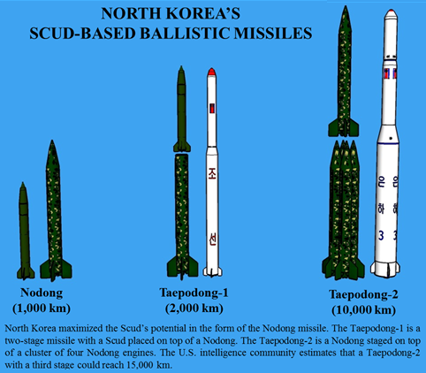
North Korea Case Study: How did North Korea’s Program Evolve?
Notes:
North Korea reverse-engineered the Scud missile, making a number of changes to improve its accuracy and extend its range.
North Korea tested an improved Scud-B in 1983, followed by a longer-range Scud-C in 1986.
North Korea maximized the potential of the Scud-based missile in the form of the 1,000 km-range Nodong missile, which it successfully flight tested in May 1993.
In the 1990s, North Korea displayed mock-ups of Scud-based rockets which used staging and clustering of engines to reach longer ranges than the Nodong.
The Taepodong-1 is a Scud staged on top of a Nodong. North Korea launched a Taepodong-1 rocket in August 1998.
The Taepodong-2 is a Nodong staged on top of a cluster of Nodong engines.
North Korea launched Taepodong-2 rockets in 2006, 2009, and twice in 2012. Only the December 2012 launch was successful.
North Korea may replicate this process with a new baseline technology based on the Soviet-designed SS-N-6 submarine-launched ballistic missile.
In 2007, North Korea revealed a land-based missile that strongly resembled the Soviet SS-N-6.
North Korea has not conducted a flight test of this missile.

Slide 12
North Korea Case Study: How did the Scud spread and how has the international community responded?
North Korea has transferred complete Scud-based ballistic missiles to many countries
The threat has motivated the IC to strengthen traditional controls on missile-related technologies and to develop more novel counter-proliferation instruments.
Missile Technology Control Regime (MTCR) members have exchanged technical information and shared “denials” to North Korea to strengthen enforcement of existing limits on the sale of long-range missile technology to North Korea.
Israel reportedly engaged in a covert effort to persuade Pyongyang to end ballistic missile sales to Middle Eastern states.
UNSCR resolutions demanding that North Korea suspend its development of long-range missiles and imposing sanctions.
Notes:
North Korea has transferred complete Scud-based ballistic missiles to many countries, including Iran, Pakistan, Syria and the United Arab Emirates.
North Korea has transferred Scud-based missile technologies to many of these same countries, as well as to countries like Egypt and Libya.
The threat posed by North Korea’s missile development and the proliferation of its missiles to other countries has motivated the international community to strengthen traditional controls on missile-related technologies and to develop more novel counter-proliferation instruments.
Members of the voluntary Missile Technology Control Regime (MTCR) have exchanged technical information and shared “denials” to North Korea to strengthen enforcement of existing limits on the sale of long-range missile technology to North Korea.
During the 1990s, the Clinton Administration initiated the so-called “Perry Process” to re-engage North Korea diplomatically, including negotiations to eliminate North Korea’s long-range ballistic missile programs in exchange for nutritional assistance and a limited number of space launches. Clinton’s term ended before the parties could reach agreement. The Bush Administration ultimately chose not to continue missile talks.
Israel reportedly engaged in a covert effort to persuade Pyongyang to end ballistic missile sales to Middle Eastern states in exchange for an unspecified compensation package.
Following a failed 2002 interdiction of a North Korean ship carrying Scud missiles to Yemen, the Bush Administration created the “Proliferation Security Initiative” to improve collaboration among states seeking to enforce existing counter-proliferation measures.
Since 2006, the United Nations Security Council has passed four resolutions demanding that North Korea suspend its development of long-range missiles and imposing sanctions on North Korea. These included: UNSCR 1718 (2006), 1874 (2009), 1985 (2011) and 2087 (2013).
Despite international sanctions, recent reports by the U.S. Office of the Director of National Intelligence and the United Nations Panel of Experts on sanctions against North Korea state that Pyongyang continues to attempt to export ballistic missile technologies and components.

Slide 13
North Korea Case Study: How does North Korea use space launches to further its program?
There are no significant differences between rockets used as ballistic missiles and rockets used to place satellites in orbit.
Rocket programs are often presented as space launch programs to deflect international suspicions.
North Korea claimed that its rocket launches were intended to place satellites in orbit.
The US believes the tests also demonstrated the military capabilities of North Korea’s ballistic missiles.
The United States intelligence community has expressed uncertainty, however, concerning whether North Korea has the capability to deploy a warhead on its missiles.
This would require North Korea to fashion a reentry vehicle
Notes:
There are no significant differences between rockets used as ballistic missiles and rockets used to place satellites in orbit.
Rocket programs, including North Korea’s, are often presented as space launch programs in an effort to deflect international suspicions while a country develops and tests technologies for offensive military use.
North Korea claimed that its rocket launches in 1998, 2009, and 2012 were intended to place satellites in orbit. (North Korea has not stated the purpose of the 2006 Taepodong-2 launch.)
Since 2009, North Korea has conducted these launches from the Sohae Satellite Launch Facility.
The United States believes the tests also demonstrated the military capabilities of its ballistic missiles, which it calls the Taepodong and Taepodong-2 missiles.
The United States intelligence community has expressed uncertainty, however, concerning whether North Korea has the capability to deploy a warhead on its missiles.
This would require North Korea to fashion a reentry vehicle to protect the missile’s warhead from extreme heat when it reenters the earth’s atmosphere.

Slide 14
North Korea Case Study: How do we monitor North Korea’s progress?
Defectors from the military complex; but how reliable is the info?
Missile tests provide important technical information.
Recovered debris.
Interdictions of illicit shipments to and from North Korea
Raise questions about the effectiveness of sanctions
Provide additional evidence about the state of North Korea’s missile program.
Open source information
Notes:
Much of what the United States knows about North Korea’s missile programs comes from defectors who may have overseen or worked in the military complex.
This information can be unreliable if not checked against other sources of intelligence, such as overhead satellite images and communications intercepts.
Missile tests provide important technical information about the state of North Korea’s missile programs.
Missile launches are monitored by technical systems such as infrared satellites in orbit and radars on the earth.
South Korea recovered debris from the December 2012 test of the Taepodong-2 to assess the state of North Korea’s rocket programs.
Interdictions of illicit shipments to and from North Korea raise questions about the effectiveness of sanctions and provide additional evidence about the state of North Korea’s missile program.
Open source information can also be a significant source of information. For instance, the Center for Nonproliferation Studies was able to use DPRK propaganda footage, defector accounts and satellite images to locate and characterize North Korea’s site for assembling missile launchers.

Slide 15
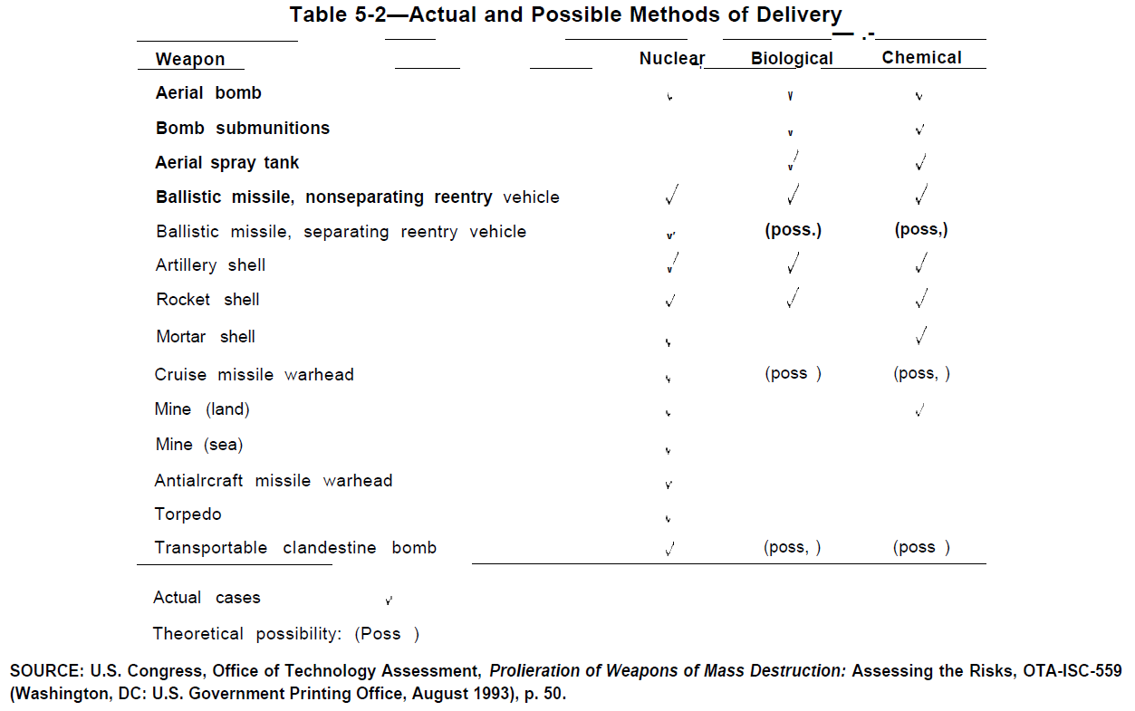
Actual and Possible Methods of Delivery
Notes:
Can you think of other systems not listed here?

Slide 16
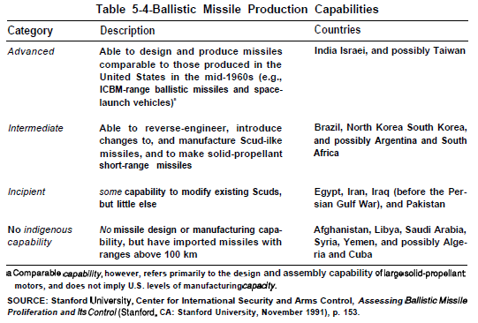
Ballistic Missile Production Capabilities

Slide 17
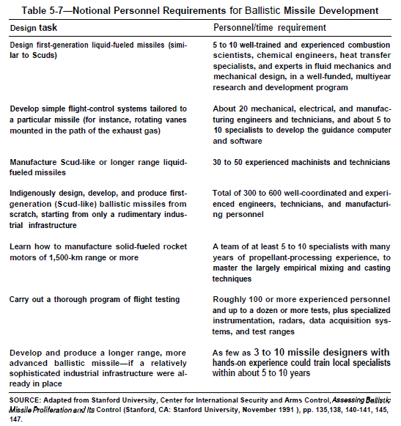
Notional Personnel Requirements for Ballistic Missile Development

Slide 18
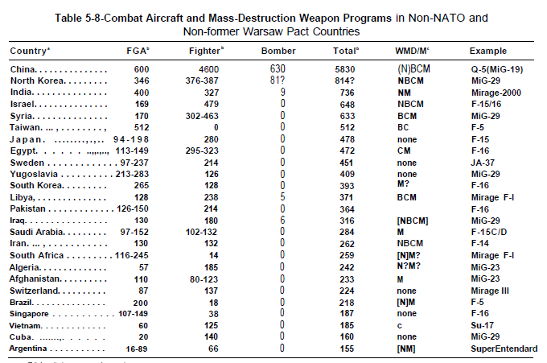
Combat A/C & WMD Programs in non-NATO countries

Slide 20
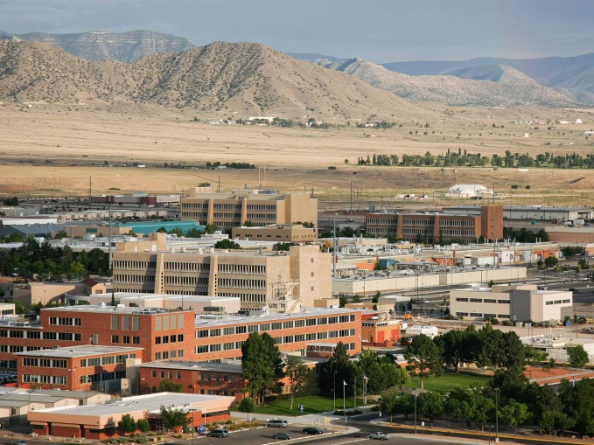
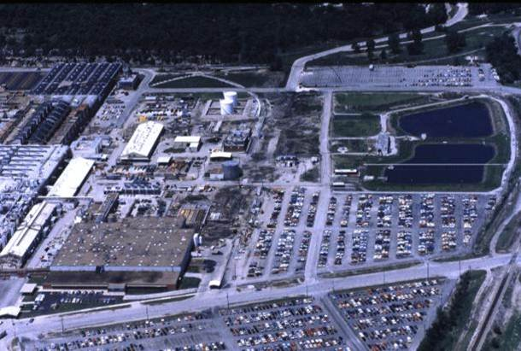
Safing, Arming, Fuzing, and Firing (SAFF) (1 of 2)
Mechanisms and procedures used to guarantee:
Safety of personnel and environment during storage, transport, and handling
Detonation of weapon at intended location and time
SAFF components account for over 85% of nuclear weapon components
Electrical
Mechanical
Plastic
Non-fissionable metal
Design and integration – Sandia
Manufacture and procure – Kansas City Plant
DESIGN
Sandia National Laboratory
MANUFACTURE / PROCURE
Kansas City Plant

Slide 21
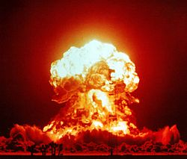


Safing, Arming, Fuzing, and Firing (SAFF) (2 of 2)
Safing
Early systems: withheld nuclear components until weapon employment
Current systems
Sealed pits with mechanical / electronic interruptions
One point safe: HE detonation at single point will not compress supercritically
Arming
Early systems: connected batteries that provided power to detonators
Current systems: signal that may depend on environment (e.g. spin rate)
Fuzing
Early systems: barometers (altitude), contact fuzes, and timers
Current systems: sensors to detect precise locations of target and weapon
Firing: signal to close switch between power and detonators
Early systems: simultaneous detonation in a microsecond was challenging
Current systems: diodes and transistors provide shorter switching times
SAFING
ARMING
FUZING
FIRING

